Slide 1
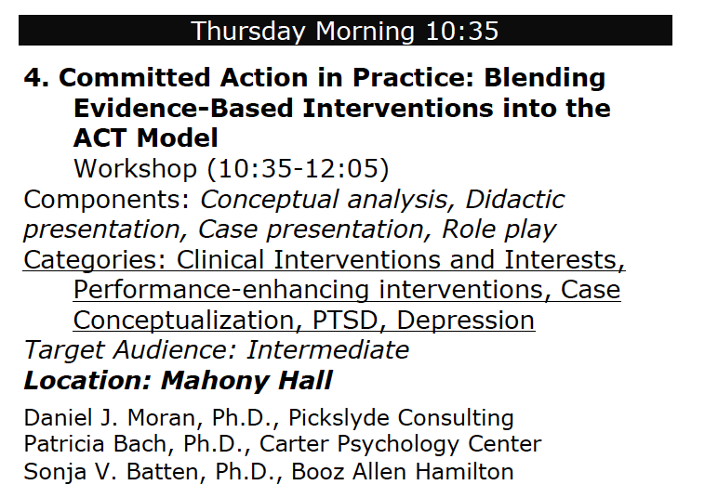

Slide 3
Disclosures (support):
Relevant Financial Relationships:
Batten employed by Booz Allen Hamilton
Bach employed by the Carter Psychology Center
Moran employed by Pickslyde Consulting and MidAmerican Psychological Institute
Moran, Bach, and Batten all receive royalties from New Harbinger publications for a book co-written on a topic similar to the subject of this presentation
Relevant Nonfinancial Relationships
Moran, Bach, and Batten have all served as Past-President of the Association for Contextual Behavioral Science

Slide 4
Disclosures (no support):
Daniel J. Moran, Sonja V. Batten, Patricia A. Bach
I have not received and will not receive any commercial support related to this presentation or the work presented in this presentation.

Slide 6
Commitment
- noun \kǝ-mit-mǝnt\
1: action aimed
in the direction of
what you care about, even in the presence of obstacles

Slide 7
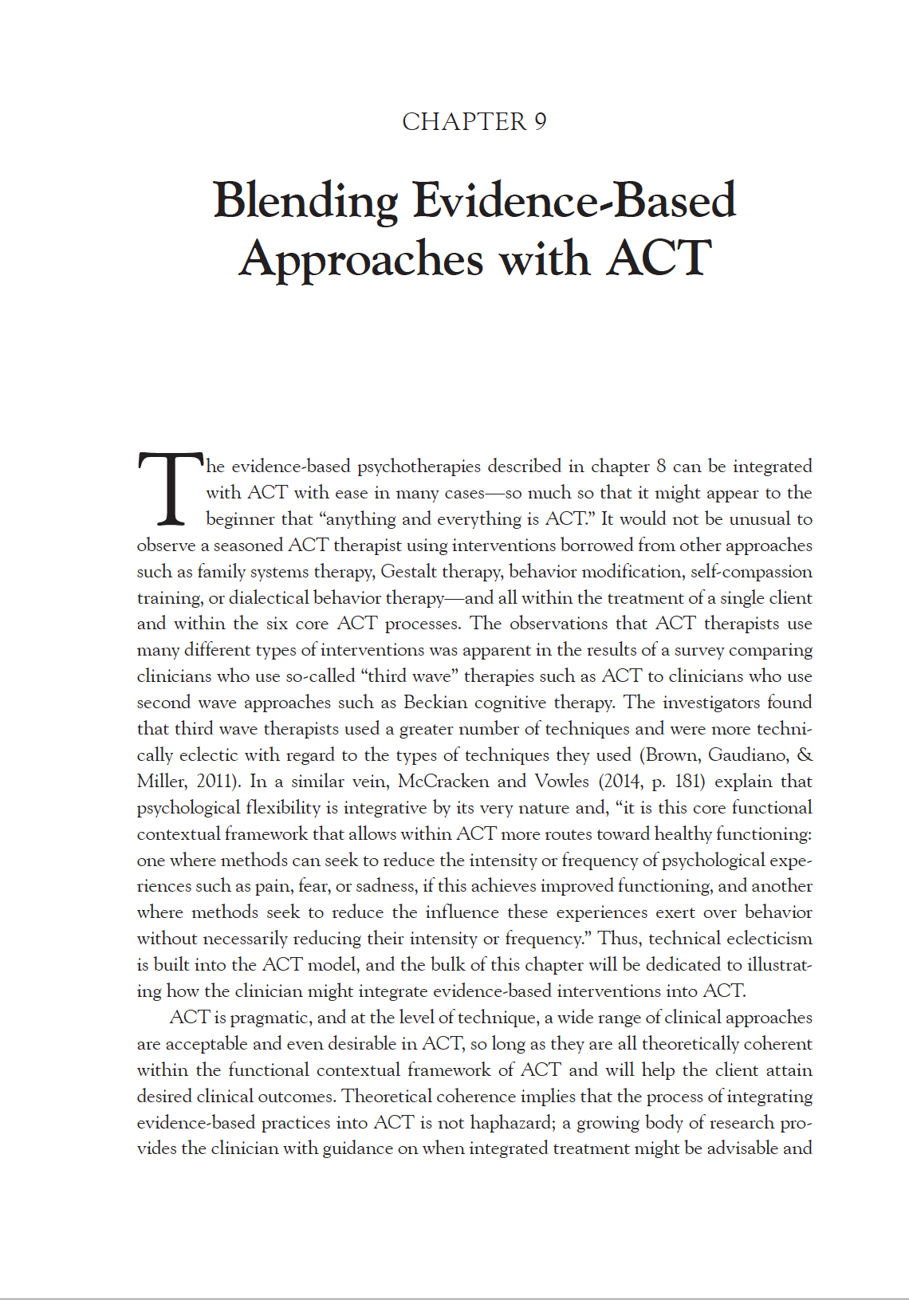
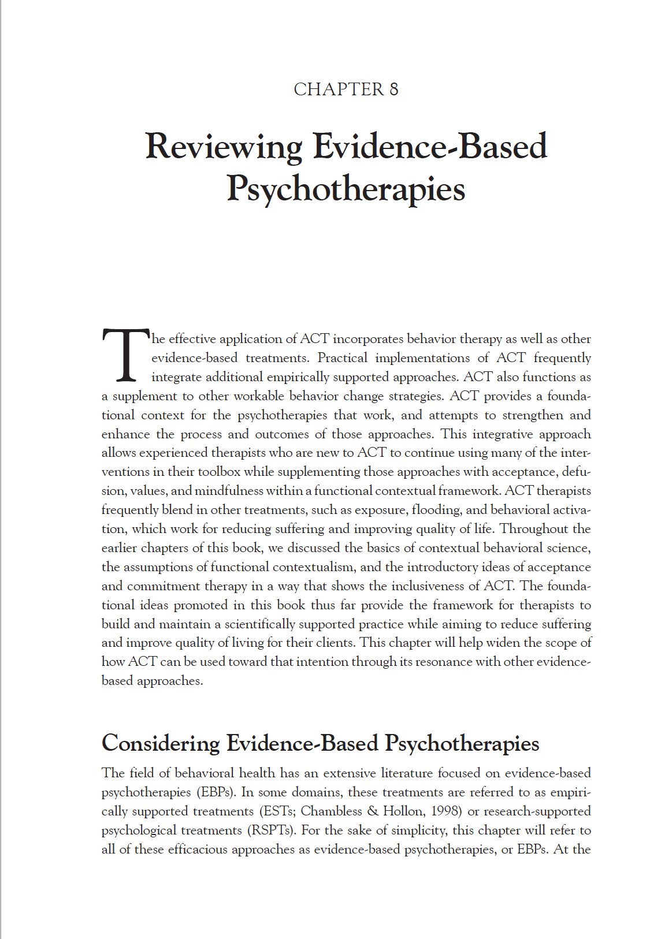

Slide 8
Acceptance & Mindfulness Processes

Slide 9
…most objectively measured?
Notes:
160 people answered a survey a few months back

Slide 10
n = 98
Notes:
Respondents from the ACT listserv said the domain that could be most objectively measured is…

Slide 11
n = 98
Values
2%
Committed Action
86%
…most objectively measured?
Notes:
Respondents from the ACT listserv said the domain that could be most objectively measured is…

Slide 12
…most want to see change?

Slide 13
n = 98
Acceptance
13%
Contact with the Present Moment
8%
Defusion
8%
Self-As-Context
17%
Committed Action
50%
Values
4%
…most want to see change?
Notes:
Like to see change

Slide 14
n = 98
Mindfulness
46%
Committed Action
50%
Values
4%
…most want to see change?
Notes:
Like to see change… but it’s not objectively measurable

Slide 15
Frequency of use on listserv

Slide 16
n = 98
Committed Action
4%
Values
19%
Acceptance
45%
Self-As-Context
20%
Contact with the Present Moment
4%
Defusion
8%
Frequency of use on listserv
Notes:
Typed in listserv

Slide 17
n = 98
Committed Action
4%
Values
19%
Mindfulness
77%
Frequency of use on listserv
Notes:
Typed in listserv

Slide 18
Committed Action
Overt behavior in the service of chosen values
Create an empirically-supported treatment plan
Establish measureable responses

Slide 19
div12.org

Slide 20
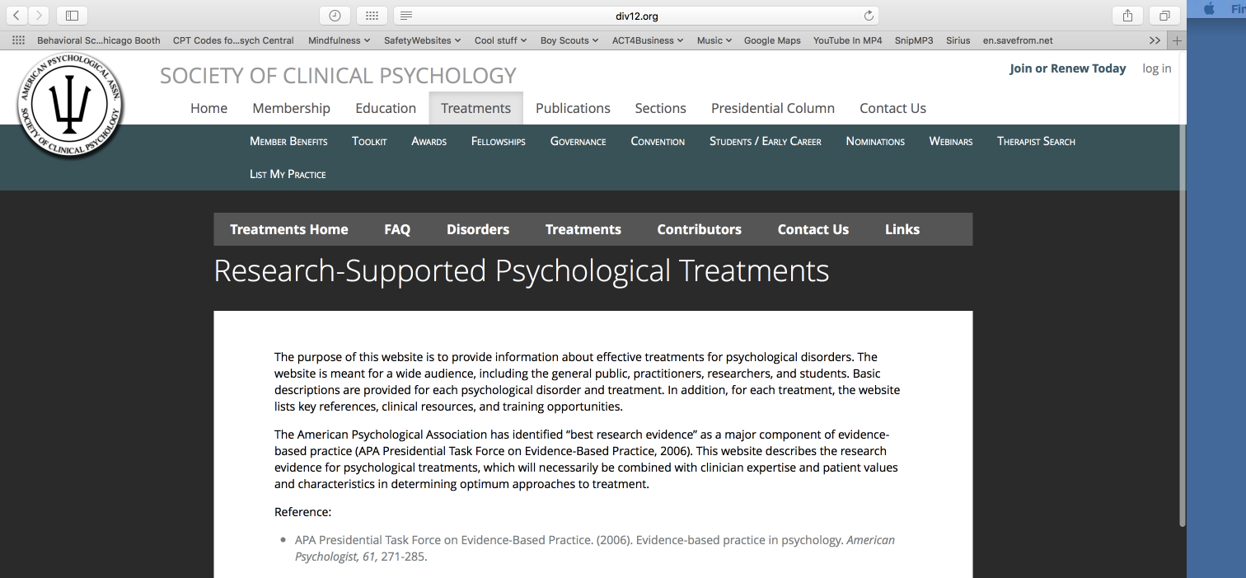
Notes:
And sometimes the resistance to hippy dippy bullshit is pretty strong… so I don’t even talk about mindful behavior too much.

Slide 21
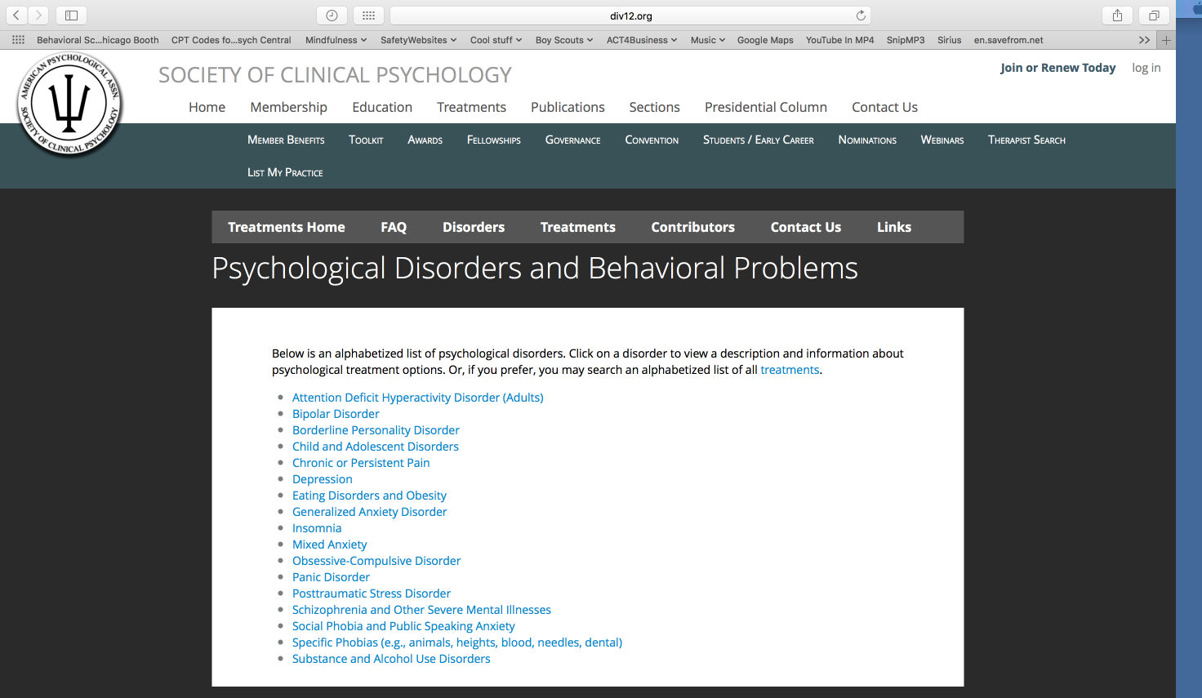
Notes:
And sometimes the resistance to hippy dippy bullshit is pretty strong… so I don’t even talk about mindful behavior too much.

Slide 22
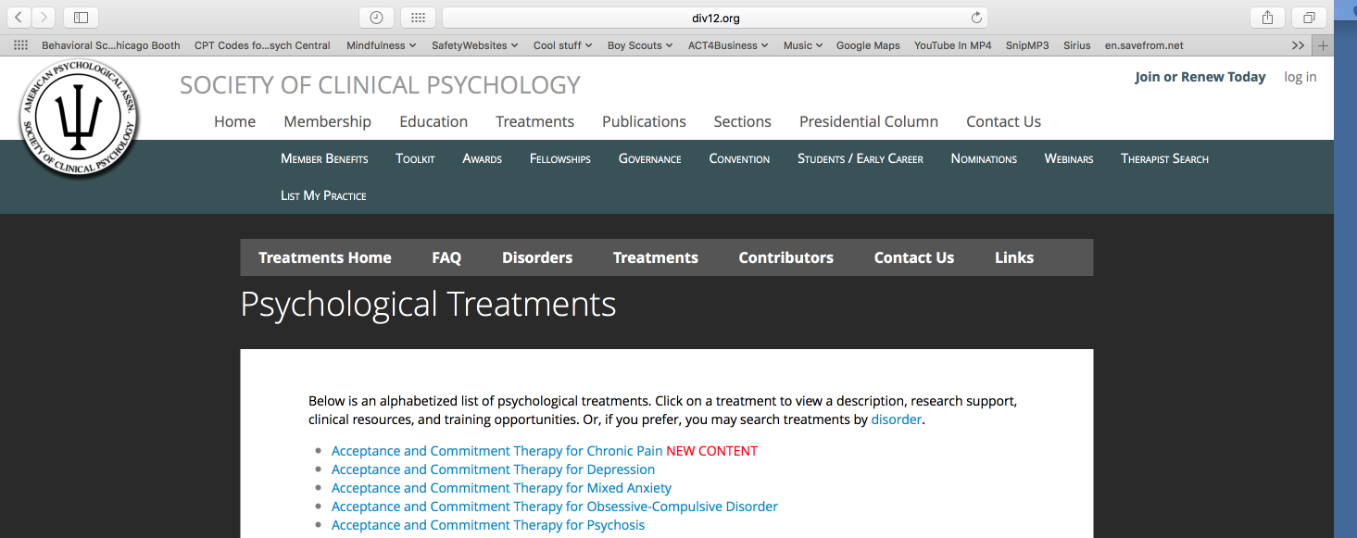
Notes:
And sometimes the resistance to hippy dippy bullshit is pretty strong… so I don’t even talk about mindful behavior too much.

Slide 23
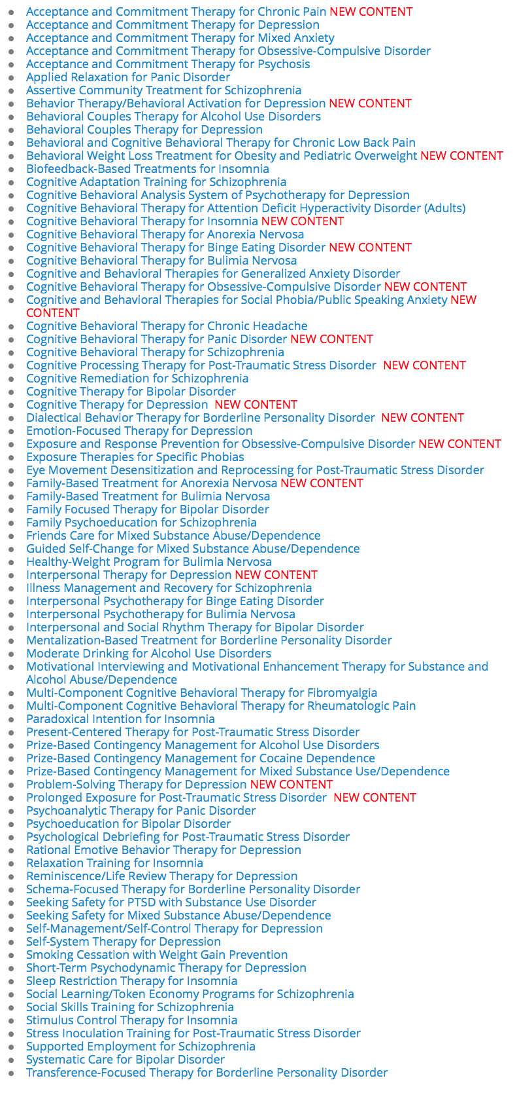
Notes:
And sometimes the resistance to hippy dippy bullshit is pretty strong… so I don’t even talk about mindful behavior too much.

Slide 24
There are 80
Research-Supported Psychological Treatments
Notes:
And sometimes the resistance to hippy dippy bullshit is pretty strong… so I don’t even talk about mindful behavior too much.

Slide 25
Behavioral Activation
Exposure Therapy
Flooding
Systematic Desensitization
Applied Behavior Analysis
Habit Reversal
Social Skills Training
Role-Play
Level Systems
Stress Inoculation Training
Exposure/ Response Prevention
Parent Management Training
Contingency Management
Behavioral Homework
Applied Relaxation
Guided Mastery
and more...

Slide 26
Exposure & Ritual Prevention
(E/RP)
for obsessive-compulsive repertories

Slide 27
Notes:
I think you are watering it down too much!
Where’s the spirituality, the self-compassion, the Eastern philosophy…
What you are doing is just… McMindfulness

Slide 28
Behavioral Activation
(BA)
for depressive repertories
Notes:
Hippy Dippy bullshit
Hotel walking meditation - Boilermakers
Using verbal events to select specific stimuli to which the person engages in response allocation exclusively, and as a consequence, expands the duration of attending.
This is not about enlightenment!
This is not about Zen Buddhism or Taoism… Situational Awareness or Mindful action is about:

Slide 29
Origins of Behavioral Activation
BA as an application of reinforcement theory to the treatment of depression (e.g., Lewinsohn, 1974)
The behavioral component of cognitive therapy treatment for depression (Beck, 1976)
BA is an independently effective intervention for depression (e.g., Dimidjian et al., 2006; Jacobson et al., 1996)
BA has evolved into a stand-alone behavioral treatment for Major Depressive Disorder (see Martell, Addis and Jacobson, 2001)
Wagner, Dimidjian, Roberts, Martell, 2009

Slide 30
Key Elements of BA
Behavioral case conceptualization
Functional analysis
Activity monitoring and scheduling
Wagner, Dimidjian, Roberts, Martell, 2009

Slide 31
Functional Analysis
Tangible/ Edible
Social/ Attention
Escape/ Avoidance
Physical
Non-social/ Automatic

Slide 33
Interpersonal and
Social Rhythm Therapy
(IPSRT)
for bipolar repertories
Notes:
Hippy Dippy bullshit
Hotel walking meditation - Boilermakers
Using verbal events to select specific stimuli to which the person engages in response allocation exclusively, and as a consequence, expands the duration of attending.
This is not about enlightenment!
This is not about Zen Buddhism or Taoism… Situational Awareness or Mindful action is about:

Slide 34
Notes:
These concerns can contribute to bipolar issues…

Slide 36
Exposure Therapy
for anxiety repertories
Notes:
Subway – Pavlovian, Skinnerian, Cognitive Restructuring
Baseball shock

Slide 38
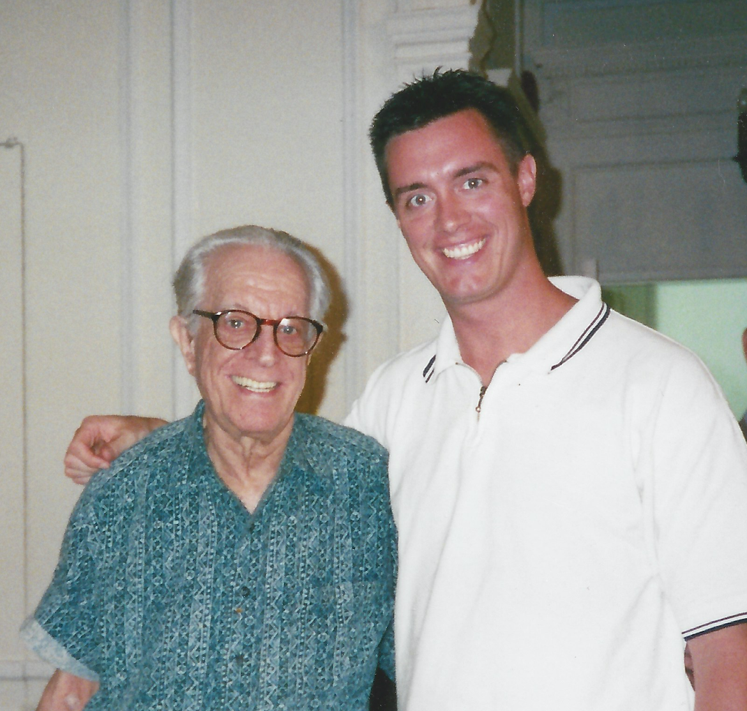
Blackledge, J. T., Moran, D. J., & Ellis, A. (2009). Bridging the divide: Linking basic science to applied psychotherapeutic interventions – A relational frame theory account of cognitive disputations in rational emotive behavior therapy. Journal of Cognitive and Rational Emotive Behavior Therapy, 27, 232-248.

Slide 40
Commitment

Slide 41
Notes:
I think you are watering it down too much!
Where’s the spirituality, the self-compassion, the Eastern philosophy…
What you are doing is just… McMindfulness

Slide 42
Parent Management Training
for children’s behavioral concerns
Notes:
Hippy Dippy bullshit
Hotel walking meditation - Boilermakers
Using verbal events to select specific stimuli to which the person engages in response allocation exclusively, and as a consequence, expands the duration of attending.
This is not about enlightenment!
This is not about Zen Buddhism or Taoism… Situational Awareness or Mindful action is about:

Slide 43
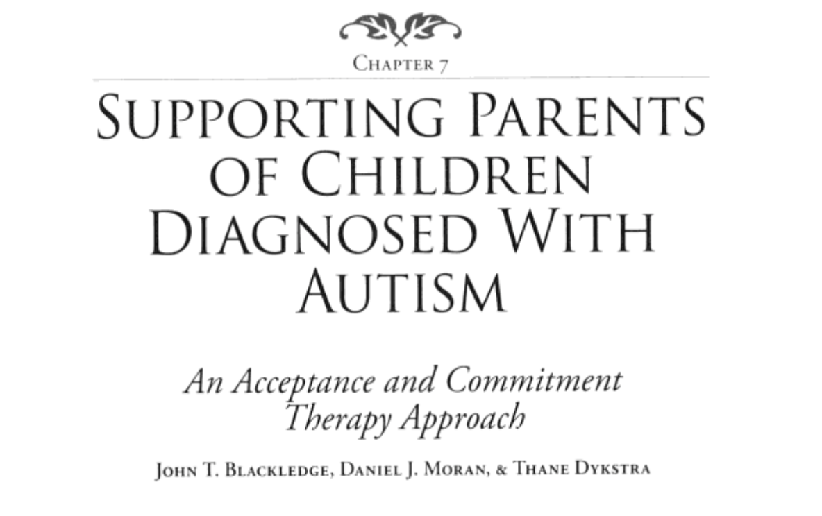
dj@pickslyde.com

Slide 45
ACT-Inspired Committed Action and Skills Training
Skills training work is frequently anxiety-provoking, both because it is often uncomfortable to learn new things, and especially if that is happening in the presence of someone else
It is important to come back to values over and over again and bringing to light whether the skills being trained and choices about engaging in the training (or not) take the person closer to their values
Participation in skills training is itself a committed action in the service of other committed actions

Slide 46
ACT-Inspired Committed Action and Role Play Activities
Role plays can be extremely helpful for skills acquisition, especially interpersonal skills
General ACT skills (acceptance, defusion) may be needed to overcome reluctance to do role plays
Role plays can then be used to overcome interpersonal barriers to committed action

Slide 47
ACT-Inspired Committed Action and Treatment of Anxiety
ACT modules on values and committed action can be effectively integrated into transdiagnostic treatments for anxiety disorders
For example, Villatte and colleagues (2016) found that values and committed action modules were useful in the treatment of generalized anxiety, and that in the treatment of PTSD, values and committed action were more helpful after several sessions of acceptance and defusion

Slide 48
In Summary: Blending ACT-Inspired Committed Action and Evidence-Based Psychotherapies
Acceptance-based committed action work can be integrated into most any evidence-based psychotherapy
Requires flexible application of the processes on the hexaflex to work with the individual to move forward both with the therapeutic steps of the evidence-based psychotherapy and directly in the person’s life

Slide 49
www.contextualscience.org djmoran.podbean.com www.drdjmoran.com dj@pickslyde.com @DrDJMoran

